Slide 1
INVESTMENT IN NAMIBIA Energy Diversification opportunities Obeth Mbuipaha Kandjoze Minister of Mines and Energy Republic of Namibia 09 November 2016

Slide 2
Outline
Mandate of the Ministry of Mines and Energy
Harambee Goal and outcomes [HPP11]
Overview Primary Energy Use
Electricity Supply Industry
Market Model
Policies under review
Legislations under review
Investment opportunities
Electricity Tariffs
Project Pipelines
Challenges and Opportunities

Slide 3
Mandate of the Ministry of Mines Energy
The Ministry of Mines and Energy is constitutionally established to take custody of Namibia’s rich endowment of mineral and energy resources and create an environment in which the mineral, energy and geological resources contribute to the country’s socio-economic development

Slide 4
Legal Framework
Petroleum Products and Energy Act No.13 of 1990, and amendments
White Paper on Energy Policy, 1998 – Under review
Electricity Act 4, 2007 – Under review
Rural Electrification Master Plan, 2000, 2005 and 2010
Off-grid Energisation Master Plan, 2007
National Integrated Resource Plan (NIRP) 2013, - Under review
IPP framework, 2005 – Under review

Slide 5
Harambee Goal and Outcomes #11 HPP11
The desired outcome/s with regard to electricity supply during the Harambee period will be
There will be zero national load shedding during the Harambee period
Increase local electricity generation capacity from 400MW to 600MW by 2020
Provisions of electricity to all schools and health facilities by 2020
Increase in the rural electrification rate from 12 percent to 50 percent by 2020

Slide 6
Overview Primary Energy Use
Namibia enjoys one of the highest solar irradiance levels in the world, thus we are the destination of choice for renewable energy projects, particularly solar photovoltaic, concentrated solar power (CSP) and solar thermal.
Other significant primary energy resources include, good wind regimes prevalent at the coastal areas, Natural Gas, Geothermal, Wave, Tidal and Uranium.
However the country is fully dependent on the import of fossil fuels.
Up to 60% of electricity is imported from neighbouring countries.
Breakdown of primary energy by type:
Fossil fuels, (Petroleum and Diesel) - 58%
Electricity, (Hydro, Solar PV, Diesel, Coal and Imports) - 20%
Biomass, (Wood and Charcoal) - 20%
Coal, 2%
Perpetual reliance on energy imports is not a sustainable option for Namibia
Any shortage of any supply will have serious negative impact on the national development aspirations.
Namibia needs considerable investments in the indigenous sources to reduce exposure .

Slide 7
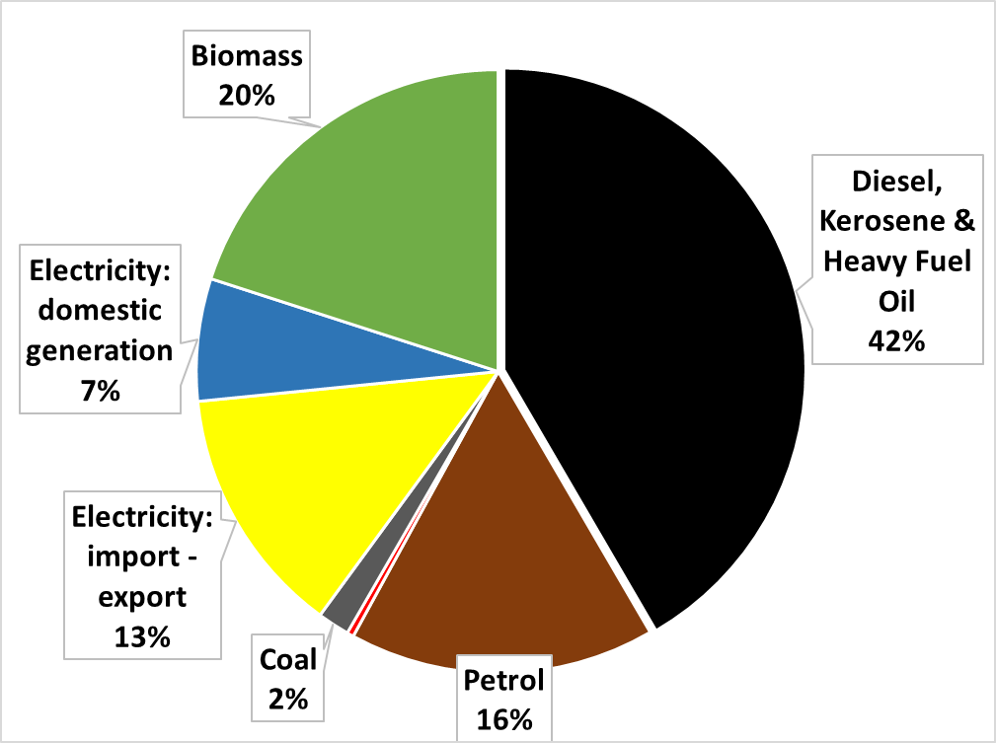
Snapshot of the Energy Sector
ESI Focus

Slide 8
Electricity Supply Industry

Slide 9
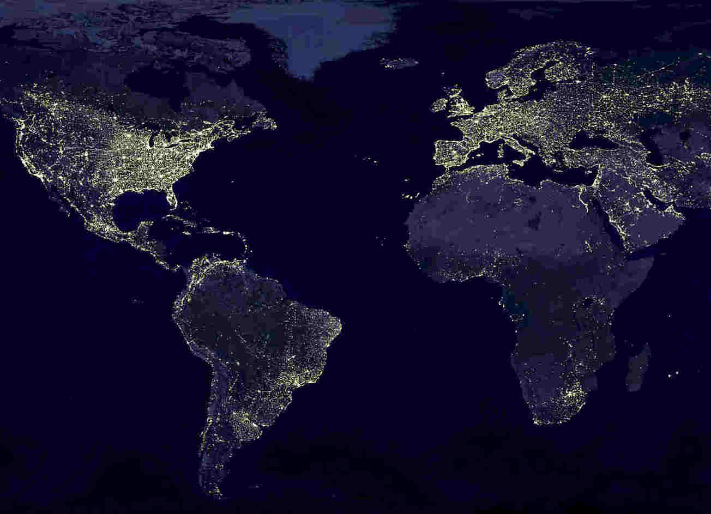
“Africa is an attractive investment partner but its full opportunity is yet to be unlocked and its progress remains obstructed by the lack of electricity…”
Earth at Night, NASA Satellite Photo, November 27, 2000

Slide 10
Structure of the Electricity Supply Industry

Slide 11
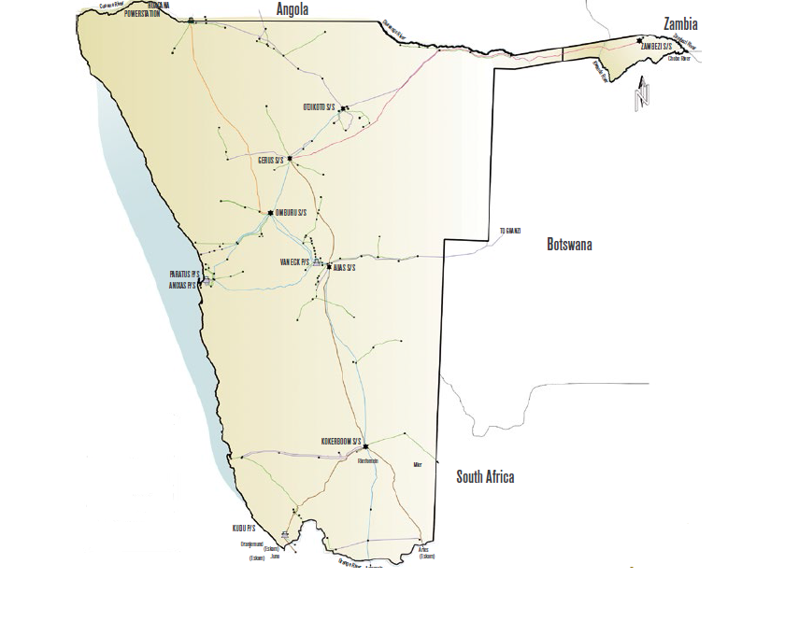
Namibia’s Electricity Existing Supply
Ruacana Hydro 345 MW
Installed capacity ~ 480 MW
HopSol 5 MW
Omburu 4.5 MW
Interconnector ~ 600 MW
HopSol 5 MW
Osona 5 MW
Max Demand in 2015 ~ 600 MW
Paratus HFO 12 MW
Van Eck Coal 81 MW
Anixas HFO 22 MW
Transmission network: ~11 000 km
Distribution network: ~22 000 km
Imports: > 60%

Slide 12
Market Model
Single Buyer Market Model
The single buyer electricity market model was adopted by Cabinet in 2000, and is current applicable model for the country,
NamPower through a trading license is the Single Buyer.
Modified Single Buyer Market Model (Proposed)
To accommodate the ever changing environment, a modified single buyer model is being discussed to allow IPP to sell directly to off takers other than the Single Buyer; i.e. REDs, Mines, and other Transmission Large Power Users
While the Electricity Bill of 2016 lays the groundwork for an updated market model, the impacts of the proposed model remain uncertain, especially in regard to its economic and institutional implications.
The electricity market model therefore requires additional work before it is ready for implementation.
The process of reviewing and updating the market model will be finalised by the last quarter of 2017.

Slide 13
Policies under Review and Development
National Energy Policy
Review of the current White Paper on Energy Policy of 1998
To achieve long-term economic empowerment, sustainable growth and national development
Stakeholder consultations on-going
Completion Target March 2017
Renewable Energy Policy
To promote development of Namibia’s RE resources
Development of the RE Policy to deal with the role of RE in the electricity sector,
Stakeholder consultation completed
Draft submitted to Minister for consideration

Slide 14
Policies under Review and Development
Independent Power Producers Policy
Address security of supply in the country through private sector investment
Review of the current IPP investors Framework
Develop an IPP Policy to guide and promote IPP investments
Completion target, March 2017
National Integrated Resource Plan (NIRP)
Planning parameter for the country’s electricity generation capacity for the next 20 years
Diversification of energy mix, including all energy resources
To be submitted to Cabinet before end of 2016

Slide 15
Legislations under Review and Development
Namibia Energy Regulatory Authority Bill (NERA)
To establish Namibia Energy Regulator for; electricity, downstream gas and petroleum, renewable energy, energy efficiency and the creation on an energy tribunal
Completion target, March 2017
Electricity Bill
To update the current Electricity Act No.4 of 2007, to reflect developments in the industry, and to improve enforcement powers,
Completion target, March 2017
Gas Bill
To regulate downstream gas, transportation, marketing, storage and related matters
Completion target, December 2017

Slide 16
Electricity Supply Industry
- Investment Opportunities

Slide 17
Opportunities in the sector Our Offer….
The Namibia Electricity Supply Industry offers an attractive investment climate, backed by a politically stable environment, clear defined energy policies, highly competitive regulatory regime offering cost reflective tariffs and other essential regulatory oversight services.
Opportunities in the Sector include:
Generation options as reflected in the National Integrated Resource Plan (NIRP),
Transmission Projects as per NamPower Transmission Master Plan,
Distribution Projects as identified by the Regional Electricity Distributors (REDs),
Off Grid Electrification Projects and Grid Electrification Projects as proposed by REDs and as recommended in the Project on Support Mechanisms to Improve the Electrification of Households in Urban and Rural Namibia.

Slide 18
Electricity Tariffs
Electricity tariffs are cost reflective as formally adopted by Cabinet.
While this has been successful in ensuring the viability of licensees in continuous supply of electricity, it has also created major upheavals, most notably as a result of the impact on the affordability of electricity.
Electricity Tariffs are set and approved by the Electricity Control Board as per the Electricity Act.
Investors are allowed a regulated return on the investment determined by the Regulator.

Slide 19
Projects Pipeline and opportunities
Interim REFIT Programme: 70MW (licenses awarded)
14 Generation licenses for 5 MW RE plants each
Procurement and PPA – complete
Two Projects commissioned
HopSol (Grootfontein and InnoSun Osona)
12 in different stages of development
Commission Target June 2017
Solar PV Tender: 37MW at Mariental
Tender under adjudication
Commission Target December 2017

Slide 20
Projects Pipeline and opportunities
Unsolicited Projects (licenses awarded)
20MW Solar PV (GreeNam)
Commission Target End 2017
44 MW Wind (Diaz)
Commission Target Early 2018
Biomass Harvesting for Electricity Generation (20MW – 30MW)
Planning stage, investment decision late 2017
To be procured on open public tender

Slide 21
Projects Pipeline and opportunities
Concentrated Solar Power (CSP) with Thermal Energy Storage (100MW – 150MW)
CSP with thermal storage
On a Public Private Partnership concept
Tender to be out early 2017
Kudu Gas and Power Development (884MW)
Opportunity for public private sector partnerships (PPPs)
Upstream
Divesting of NamCor interest
Downstream
Equity in the Kudu Power

Slide 22
Projects Pipeline and opportunities
Hydro Power
Baynes (600MW)
Lower Orange Hydro (80MW – 120MW)
To be procured on open public tender
Mini Grids / Off grid Electrification
Public Private Partnership arrangements for mini grids and off grid electrifications
MME is keen to discuss proposals with the investors

Slide 23
NEW GENERATION CAPACITIES and Opportunities
2016 - 2026
Biomass Plants
– 3x10 MW
Paratus Upgrade
- 60 MW
Remaining REFIT
NamPower PV – 37 MW
Arandis
CSP Plant
97 MW
90 MW
100-150 MW
Commissioning
Dec 2017
Commissioning
Jun 2020
Commissioning
Aug 2021
1153 MW
Jun 2016
Commissioned
Dec 2018
Commissioning
Dec 2020
Commissioning
Dec 2026
Commissioning
10 MW
64 MW
442 MW
300 MW
1st REFIT Hopsol - 5MW
2nd REFIT Innosun - 5MW
Diaz Wind – 44 MW
GreeNam PV – 20MW
Kudu Project – 884MW
Baynes Hydro Project
300 MW
640 MW
HPP

Slide 24
Final Thoughts
While recognizing the remarkable successes the Government of Namibia has recorded in sustainably financing critical service sectors such as Health, Education and Infrastructure Development through the Fiscus, global market forces and other factors have continued to negatively impact on state revenue sources.
It is against this background that Namibia wishes to engage Development Partners and Investors to mobilize resources to finance projects for the energy sector, which is a vital engine for overall economic growth.
The Ministry of Mines and Energy is committed to
Align the Policies and Legislations to address the current challenges
Increase amount of local generated electricity with focus on base load and mid merit plants
Increase access to electricity
Increase private investment in the energy industry

Slide 25
Conclusion
When citizens are without access to electricity, they are by implication, excluded from actively participating in national economic development activities.
This is contrary to the Harambee Prosperity Plan principle of inclusivity of all citizens and also not in line with the commitment to industrialize Namibia as articulated in vision 2030.
All the efforts to electrify, improve access, and address the issue of security of supply, are meant to compliment the initiatives also articulated in the Government Harambee Prosperity Plan for the energy sector.
I urge the investors to get into contact with the Electricity Control Board, NamPower for detailed information on specific projects.
It is our commitment to engaging development partners to mobilize resources to ensure success of these important projects.

Slide 26
Thank you!

